Slide 1
UNIT-I ASSISTIVE TECHNOLOGY FOR COMMUNICATION
Prepared by
Ms.G.Sudhanthira (AP/BME)

Slide 2
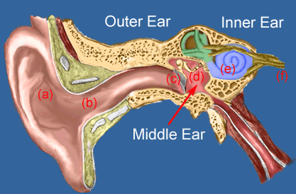
Human ear anatomy and physiology
The human ear is a complex organ responsible for detecting sound and helping with balance. It can be divided into three main parts: the outer ear, middle ear, and inner ear. Each part plays a distinct role in the process of hearing.
1. Outer Ear
The outer ear consists of:
Pinna (Auricle): The visible part of the ear that helps collect sound waves.
Ear Canal (External Auditory Canal): A tube that channels the sound waves to the eardrum.
Function: The pinna gathers sound waves from the environment and directs them through the ear canal toward the eardrum (tympanic membrane).

Slide 3
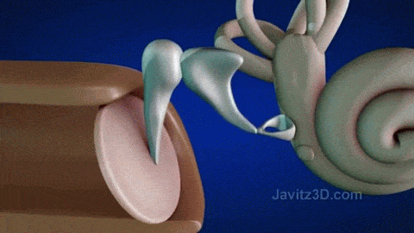
Human ear anatomy and physiology
2. Middle Ear
The middle ear contains:
Eardrum (Tympanic Membrane): A thin membrane that vibrates when sound waves hit it.
Ossicles: Three tiny bones (the malleus, incus, and stapes) that amplify the vibrations from the eardrum.
Malleus (hammer)
Incus (anvil)
Stapes (stirrup)
Function: When the eardrum vibrates due to sound waves, these vibrations are transferred to the ossicles, which amplify the sound and transmit it to the inner ear.

Slide 4
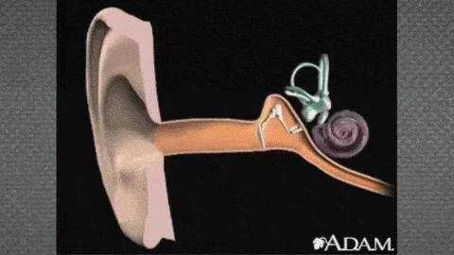
Human ear anatomy and physiology
3. Inner Ear
The inner ear consists of:
Cochlea: A spiral-shaped, fluid-filled structure that contains hair cells (sensory receptors).
Auditory Nerve: Carries signals from the cochlea to the brain.
Semicircular Canals: Fluid-filled structures that help with balance (not directly related to hearing).
Function: The vibrations from the ossicles are transferred to the cochlea. Inside the cochlea, these vibrations create waves in the fluid, stimulating the hair cells. The movement of the hair cells generates electrical signals, which are sent via the auditory nerve to the brain for interpretation as sound.

Slide 5
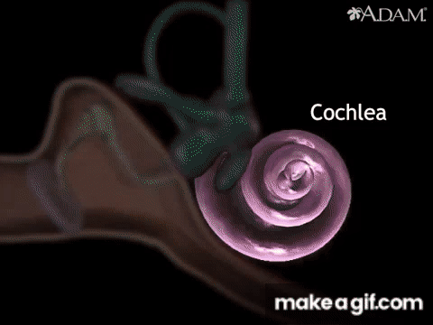
https://www.youtube.com/watch?v=p3Oy4lodZU4

Slide 6
Normal Hearing frequencies and degree of hearing loss
Normal Range of Hearing Frequency
The normal hearing range for humans is typically between 20 Hz to 20,000 Hz (20 kHz).
Low frequencies (bass sounds): 20 Hz – 250 Hz
Midrange frequencies: 250 Hz – 4,000 Hz
High frequencies (treble sounds): 4,000 Hz – 20,000 Hz
Humans are most sensitive to frequencies between 2,000 Hz and 5,000 Hz, which is the range most common in human speech.
Degrees of Hearing Loss
Hearing loss is also classified based on its severity:
Mild: Difficulty hearing soft sounds (25–40 dB HL)
Moderate: Difficulty hearing normal conversation (41–55 dB HL)
Moderately Severe: Significant difficulty with conversation (56–70 dB HL)
Severe: Little to no understanding of speech without amplification (71–90 dB HL)
Profound: Hearing is limited to very loud sounds or vibrations (> 90 dB HL)

Slide 7
Hearing loss vs. Deafness
Hearing loss: This is a reduced ability to hear sounds in the same way as other people.
Deafness: This occurs when a person cannot understand speech through hearing, even when sound is amplified.
Profound deafness: This refers to a total lack of hearing. An individual with profound deafness is unable to detect sound at all.
Types:
There are three different types of hearing loss
Conductive hearing loss: Vibrations are not passing through from the outer ear to the inner ear, specifically the cochlea.
Sensorineural hearing loss: Hearing loss is caused by dysfunction of the inner ear, the cochlea, auditory nerve, or brain damage.
Mixed hearing loss: A combination of conductive and sensorineural hearing loss.
There are two types of deafness
Unilateral deafness
Bilateral deafness

Slide 8
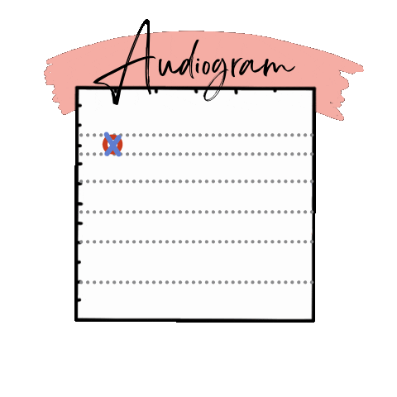
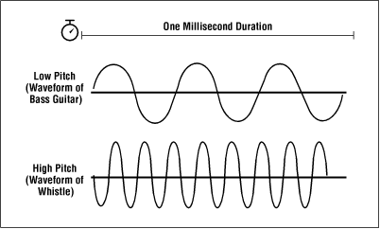
Audiogram
An audiogram is a graph that visually represents a person's hearing ability across a range of frequencies. It is the result of a pure-tone audiometry test and helps to determine the type and degree of hearing loss. The audiogram shows the softest sounds (thresholds) a person can hear at different pitches (frequencies).
The X-axis represents the frequency (pitch) in Hertz (Hz), typically ranging from 125 Hz to 8,000 Hz. The Y-axis represents intensity (loudness) in decibels (dB), ranging from -10 dB (softest sound) to 120 dB (loudest sound).

Slide 9

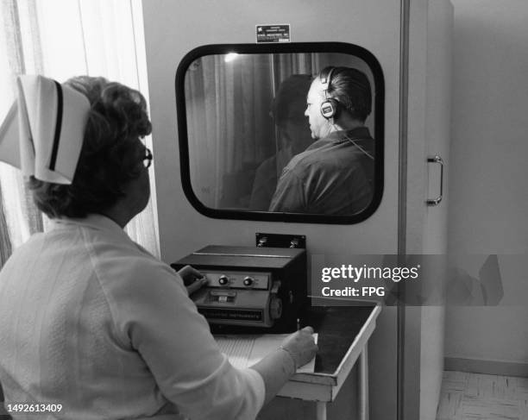
Audiogram
Working of an Audiogram: Step-by-Step Process
Test Setup:
The patient is seated in a soundproof booth to minimize environmental noise.
They are fitted with headphones or insert earphones for air conduction testing, and a bone conductor for bone conduction testing (placed on the mastoid bone behind the ear).

Slide 10

Audiogram
Types of Sounds Tested
1. Pure Tones: These are simple sound waves played at various frequencies, which help to identify the threshold of hearing at different pitches. Common frequencies tested range from 125 Hz to 8,000 Hz.
2. Air Conduction: This involves sound traveling through the outer, middle, and inner ear.
3. Bone Conduction: Involves bypassing the outer and middle ear to test the inner ear’s function directly.

Slide 11
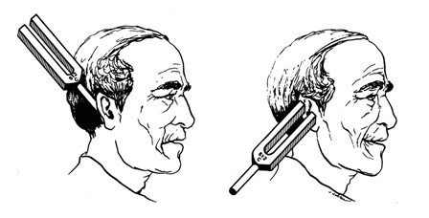
Audiogram
Types of Sounds Tested
1. Pure Tones: These are simple sound waves played at various frequencies, which help to identify the threshold of hearing at different pitches. Common frequencies tested range from 125 Hz to 8,000 Hz.
2. Air Conduction: This involves sound traveling through the outer, middle, and inner ear.
3. Bone Conduction: Involves bypassing the outer and middle ear to test the inner ear’s function directly.

Slide 12
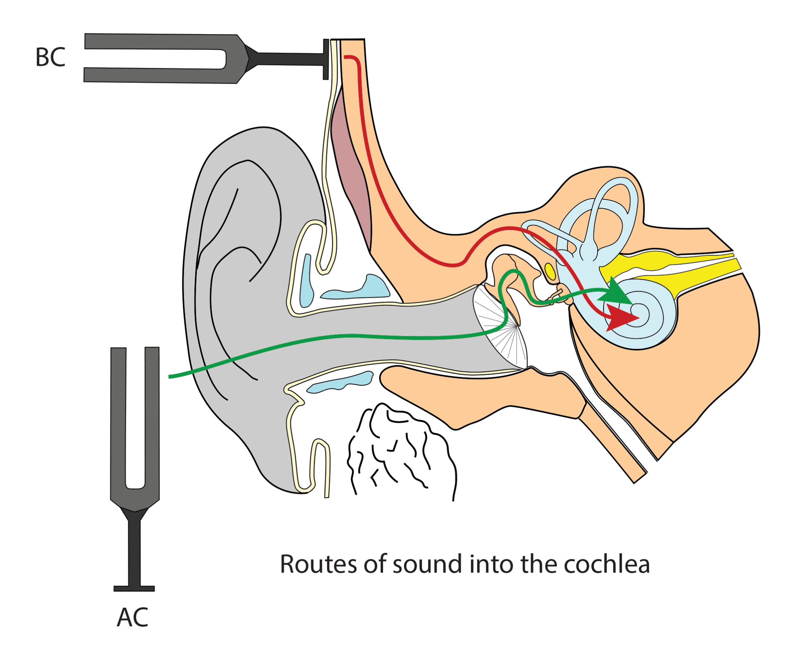
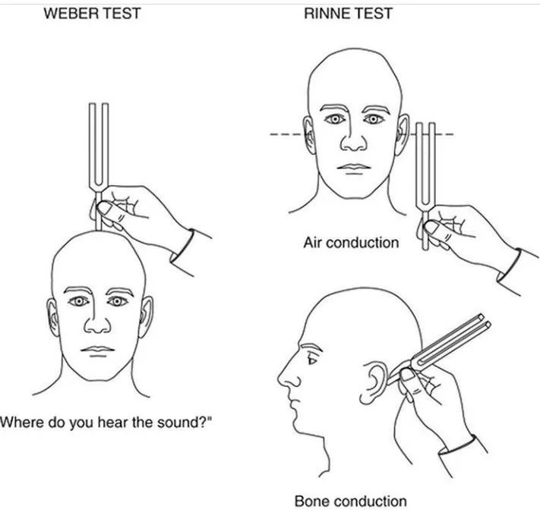
Audiogram
Air Conduction Testing:
This test measures how well sound travels through the entire hearing system (outer ear, middle ear, and inner ear).
Pure tones at different frequencies (125 Hz – 8,000 Hz) are played through the headphones.
The patient is asked to press a button or raise a hand each time they hear a sound, no matter how soft.
The examiner adjusts the intensity (volume) of each tone to find the quietest sound the patient can hear at each frequency. This threshold is recorded for both ears and plotted on the audiogram.

Slide 13
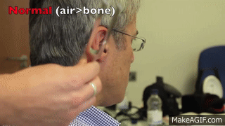

Audiogram
Bone Conduction Testing:
This test bypasses the outer and middle ear to evaluate the function of the inner ear (cochlea) and the auditory nerve.
A bone vibrator is placed on the mastoid bone behind the ear. The vibrations directly stimulate the inner ear.
Like in air conduction testing, the intensity is varied to determine the patient’s threshold for hearing through bone conduction. These thresholds are also plotted on the audiogram.

Slide 14
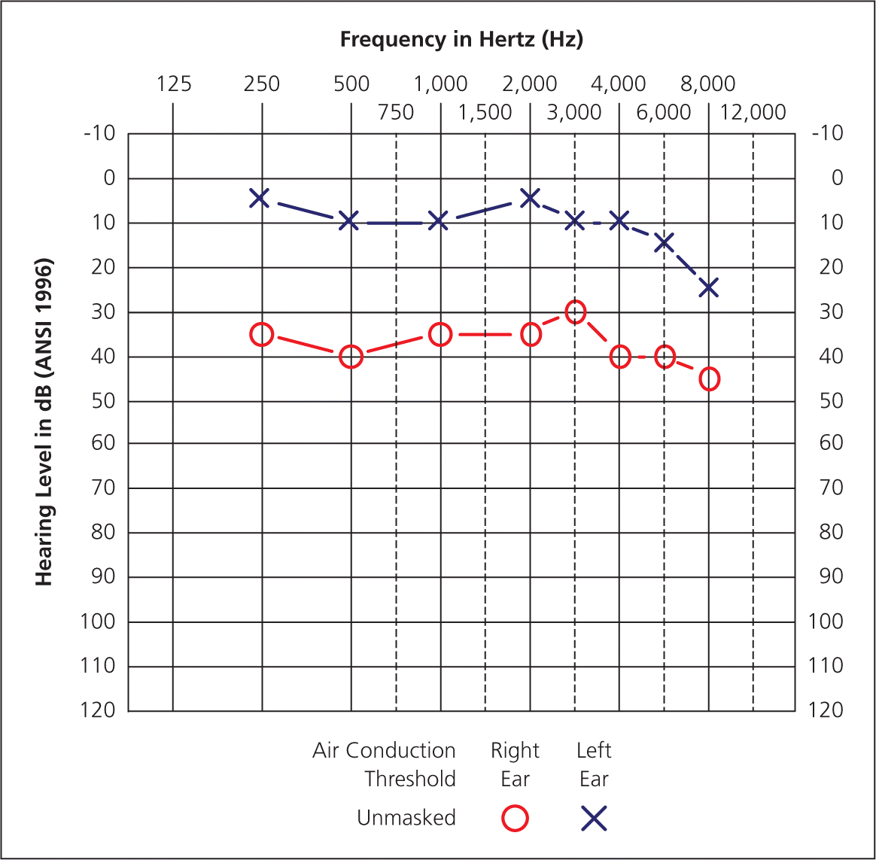
Audiogram
Threshold Plotting:
The hearing thresholds for each frequency (both air and bone conduction) are plotted on the audiogram.
Symbols like "O" for the right ear and "X" for the left ear are used to represent air conduction thresholds. "<" and ">" symbols represent bone conduction thresholds.
Video : https://www.youtube.com/watch?v=AQHKqiJbzF0

Slide 15
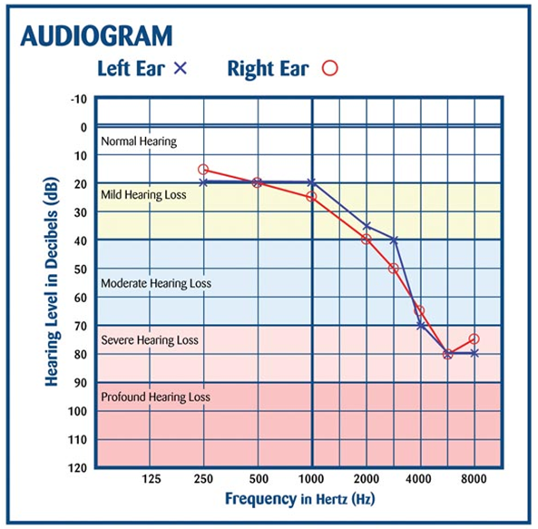
Audiogram
Result Interpretation:
The distance between air conduction and bone conduction thresholds is used to identify the type of hearing loss:
Conductive hearing loss: Air conduction thresholds are worse (higher dB) than bone conduction thresholds. This indicates a problem in the outer or middle ear.
Sensorineural hearing loss: Both air and bone conduction thresholds are equally impaired, indicating damage to the inner ear or auditory nerve.
Mixed hearing loss: Both air and bone conduction thresholds are impaired, but air conduction thresholds are worse, indicating a combination of conductive and sensorineural hearing loss.
The vertical position of the thresholds on the graph indicates the degree of hearing loss (mild, moderate, severe, or profound).

Slide 16
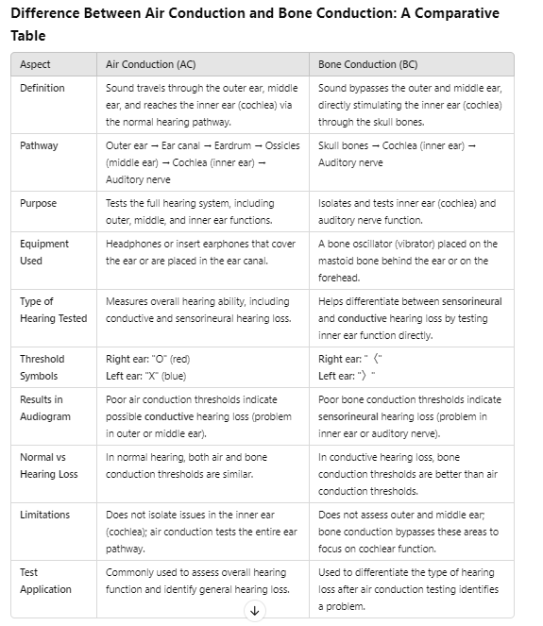

Slide 17
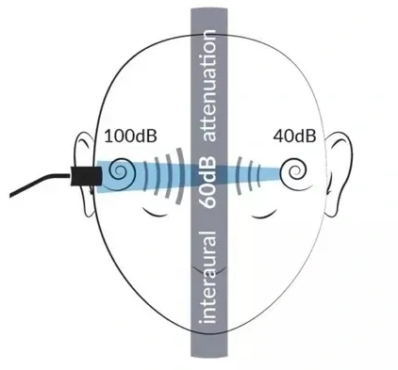
Masking Technique in Audiometry
The masking technique in audiometry is used to prevent the non-test ear from detecting sounds meant for the test ear during a hearing test. This ensures that each ear's hearing ability is accurately assessed without interference or "cross-hearing." Masking is crucial when there's a significant difference in hearing sensitivity between the ears or when testing for bone conduction, where sound vibrations can easily travel through the skull to both ears.

Slide 18
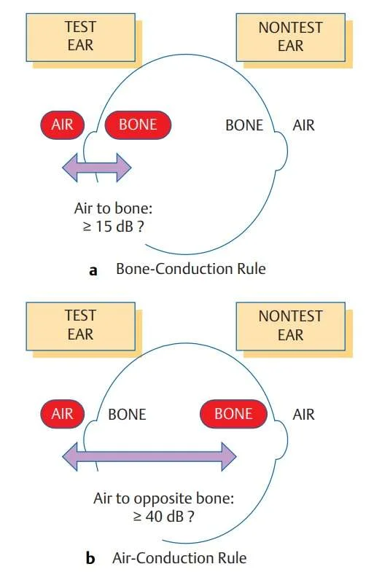

Slide 19
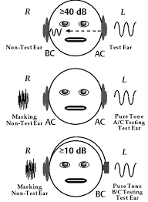
Why Masking is Needed
When testing one ear (test ear), sound may be heard in the opposite ear (non-test ear), especially if:
There is a significant hearing loss in the test ear.
The sound levels are high enough to "cross over" to the better-hearing ear.
Without masking, the audiogram results may inaccurately reflect the hearing abilities of the non-test ear rather than the test ear. Masking is done by introducing noise into the non-test ear to block it from hearing the test tones.

Slide 20
Principles of Masking
Interaural Attenuation (IA): When sound crosses over from the test ear to the non-test ear, some of the sound energy is absorbed by the head. This energy reduction is known as interaural attenuation (IA).
For air conduction with headphones: IA is approximately 40 dB.
For air conduction with insert earphones: IA is approximately 60 dB.
For bone conduction: IA is 0 dB (because bone conduction stimulates both cochleas directly).
Cross-Hearing: When a sound is loud enough to reach the non-test ear, it can interfere with testing, causing inaccurate results. Masking ensures that the sound presented to the test ear does not cross over to the non-test ear.
Effective Masking: To mask, a noise (typically narrowband noise) is played in the non-test ear. The intensity of this masking noise must be loud enough to "cover" the hearing sensitivity of the non-test ear but not so loud that it interferes with the test ear.

Slide 21
Masking Procedure
Air Conduction Masking:
If the air conduction threshold in the test ear is significantly worse than in the non-test ear, masking is applied to the non-test ear.
For example, if the threshold difference between ears exceeds 40 dB with headphones, masking noise is introduced in the non-test ear at a level just loud enough to keep it from hearing the sound meant for the test ear.
Bone Conduction Masking:
Because bone conduction stimulates both cochleas, masking is typically needed for bone conduction testing, particularly if there is a significant air-bone gap (i.e., when bone conduction thresholds are better than air conduction thresholds by 10 dB or more).
Narrowband noise is applied to the non-test ear, allowing the tester to isolate the response from the test ear.

Slide 22
Types of Noise Used for Masking
Narrowband Noise (NBN):
Narrowband noise is a filtered noise centered around the test frequency. It is the most common masking noise used because it targets the specific frequency being tested, minimizing the amount of noise applied.
White Noise:
White noise consists of equal energy at all frequencies, but it can be unnecessarily broad for masking, affecting more than just the test frequency. It is not typically used in audiometry.
Speech Noise:
This type of noise is used when testing speech recognition thresholds. It simulates the frequency spectrum of speech, ensuring the non-test ear cannot understand or respond to the speech being tested in the test ear.
Example of Masking Application
Scenario: If a patient has a severe hearing loss in the right ear and normal hearing in the left ear, during air conduction testing, the sound delivered to the right ear could be loud enough to "cross over" to the left ear. This would lead to inaccurate results. Masking noise is applied to the left ear to ensure that any responses are coming from the right ear only.

Slide 23
Challenges in Masking
Overmasking: If the masking noise is too loud, it can interfere with the ability to hear sounds in the test ear, leading to inaccurate results.
Undermasking: If the masking noise is too soft, it may not effectively block the non-test ear from hearing the test sounds, leading to inaccurate audiogram results.
Central Masking: In some cases, the presence of masking noise in one ear may slightly elevate the threshold of the test ear (by about 5 dB), even though the masking noise is not presented to the test ear.

